Slide 1
The Story of Pluto
By Melissa Valenzuela
Intern at Lowell Observatory
Project supervised by Lauren Amundson

Slide 2
Problem, Objective, and Questions
Problem/Objective:
To create a comprehensive, yet accessible, digital exhibit about Pluto’s history and legacy.
Questions:
How/When was Pluto discovered?
Who were the key people involved in the search for Pluto?
How did the discovery influence planetary science?
How did the public react to the discovery?
What is Pluto’s legacy today?

Slide 3
Phase 1
Digging into
the Collection

Slide 4
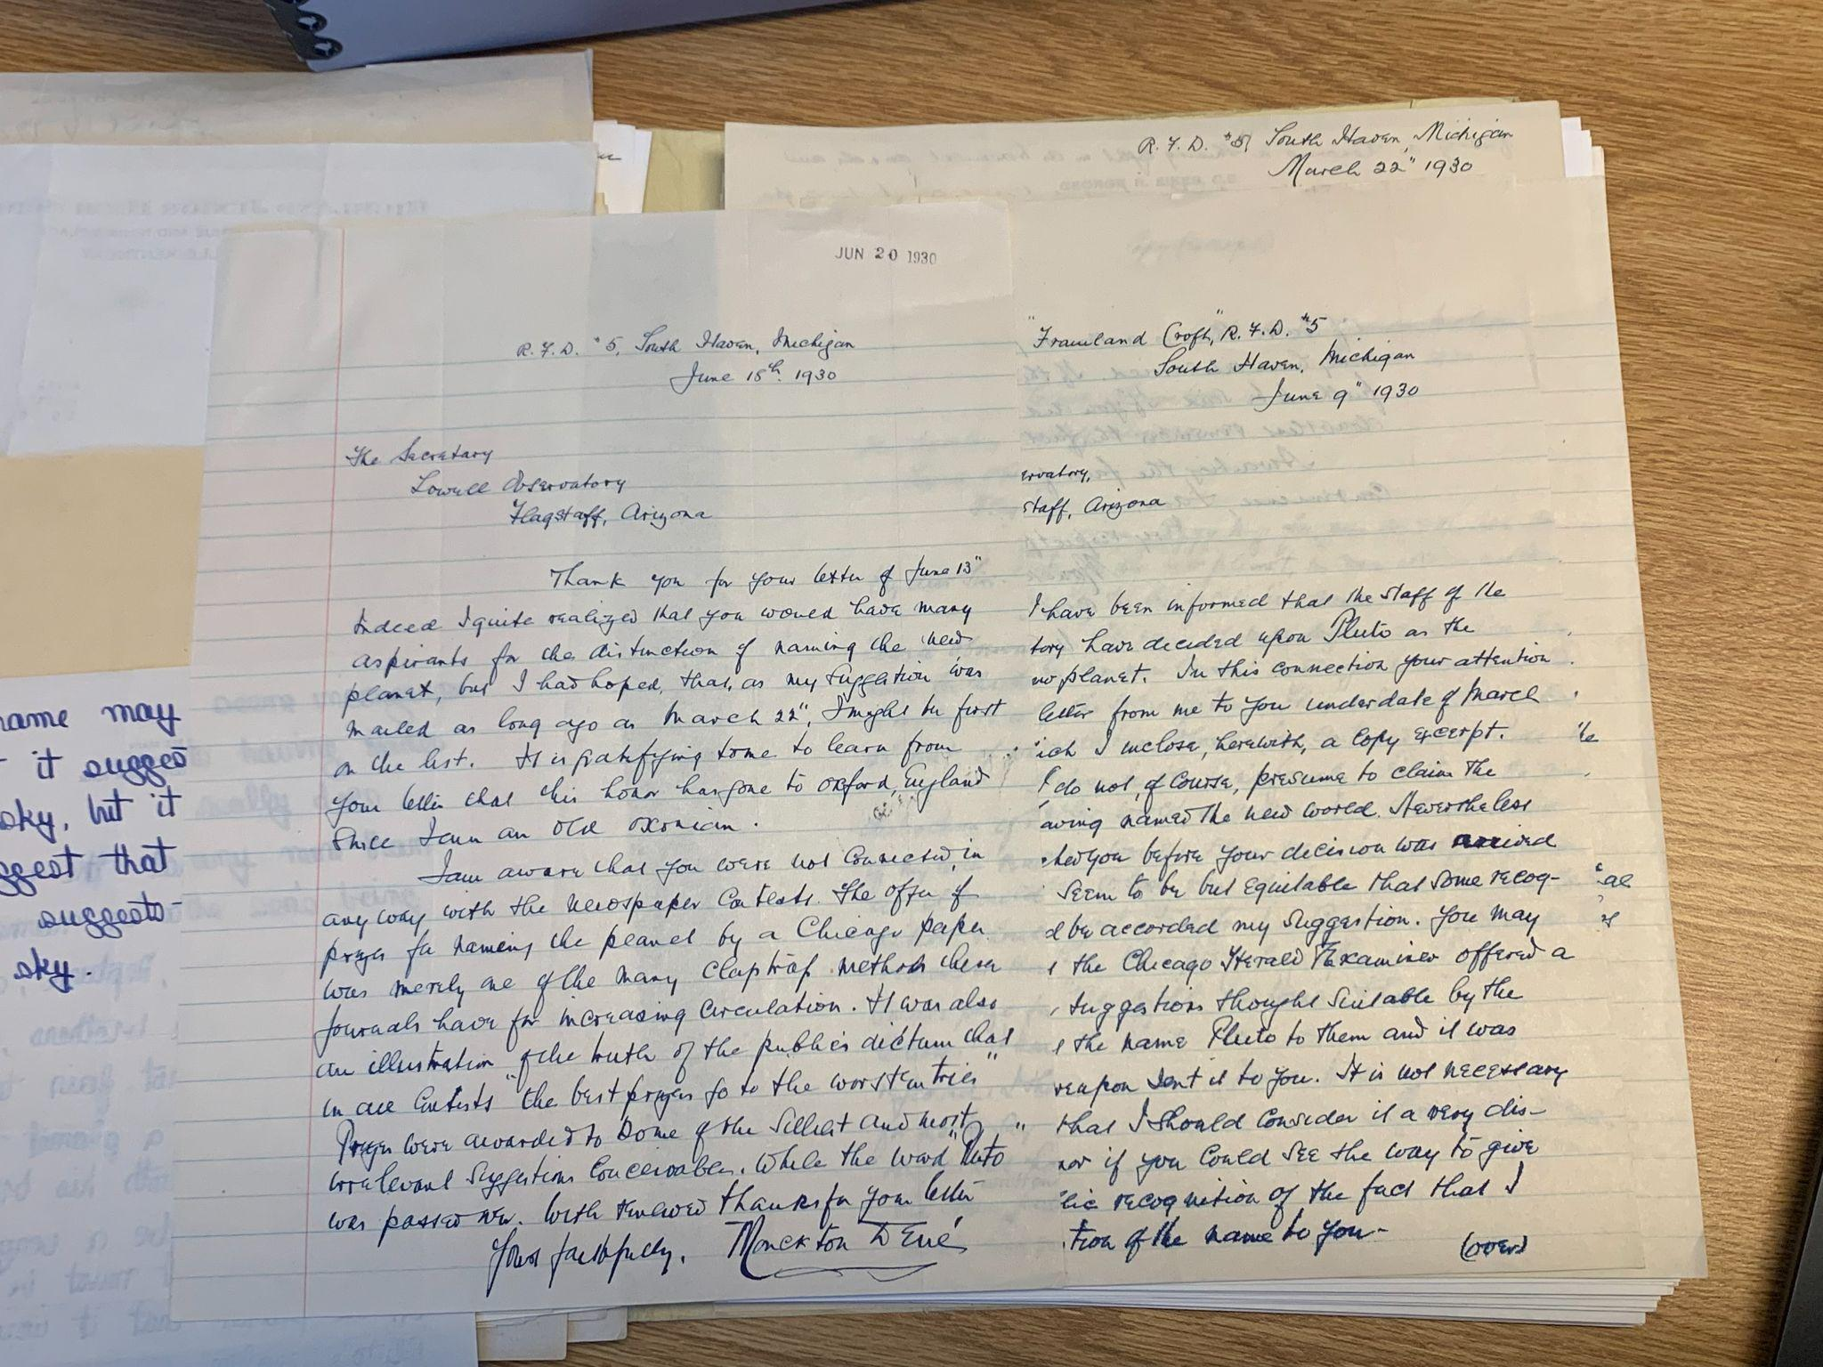
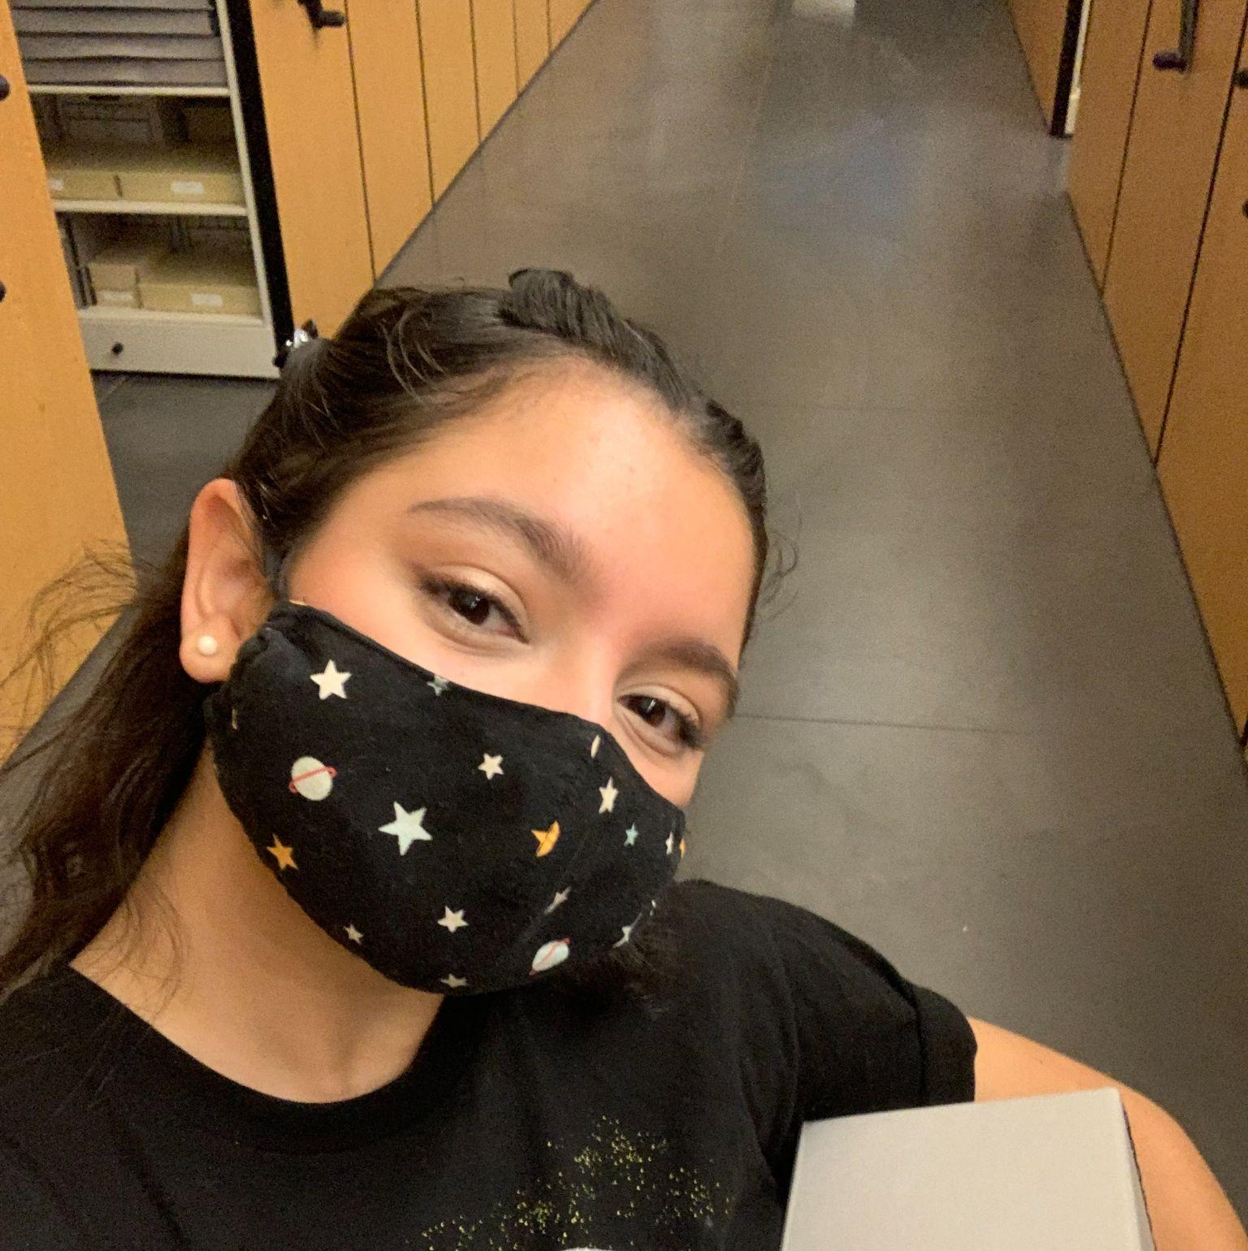
Selecting Items for the Exhibit
I started my initial research by familiarizing myself with the Pluto Collection in Lowell Observatory’s archives. There are seven boxes in the collection, each with 7-10 files of letters, photos, newspaper clippings, and other historical documents.
The key to a successful exhibit is to find artifacts which best tell the story that you want to share. This means that not every single document will be useful. Archivists and Curators must make decisions about what kind of items are most relevant and interesting to a wider audience.

Slide 5
Selection and Organization Process
With the help of my mentor, I identified five main categories that would make up the digital exhibit:
The Search for Planet X
Discovery
Public Reaction
New Horizons
Pop Culture
Using this framework, I selected documents and objects that were most relevant to the five categories. I digitized materials from the Pluto Collection and also utilized other resources, like the Arizona Memory Project where my mentor had already digitized some important artifacts related to Pluto.

Slide 6
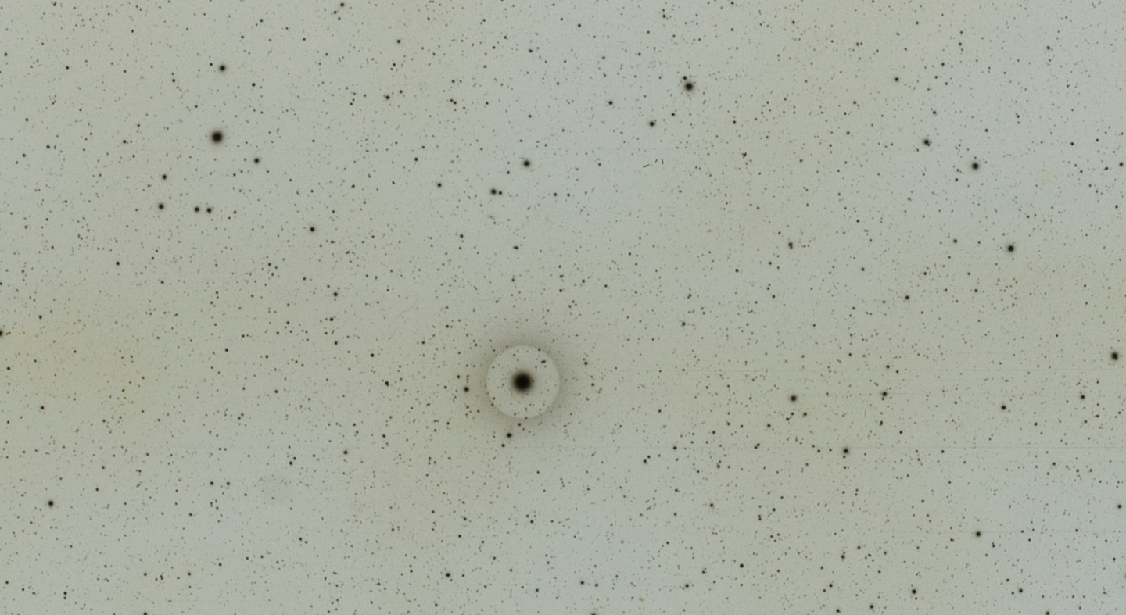
Pluto Discovery
Plate
January 23, 1930

Slide 7
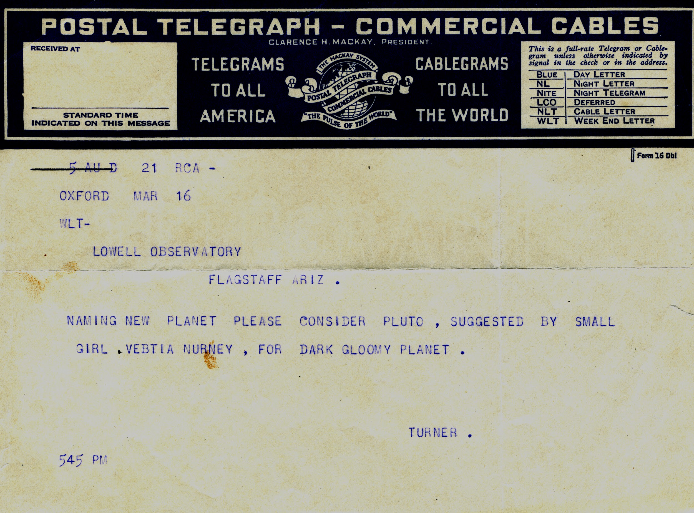
Telegram from 12 year old Venetia Burney suggesting the name Pluto
March 16, 1930

Slide 8
Phase 2
Building the Exhibit

Slide 9
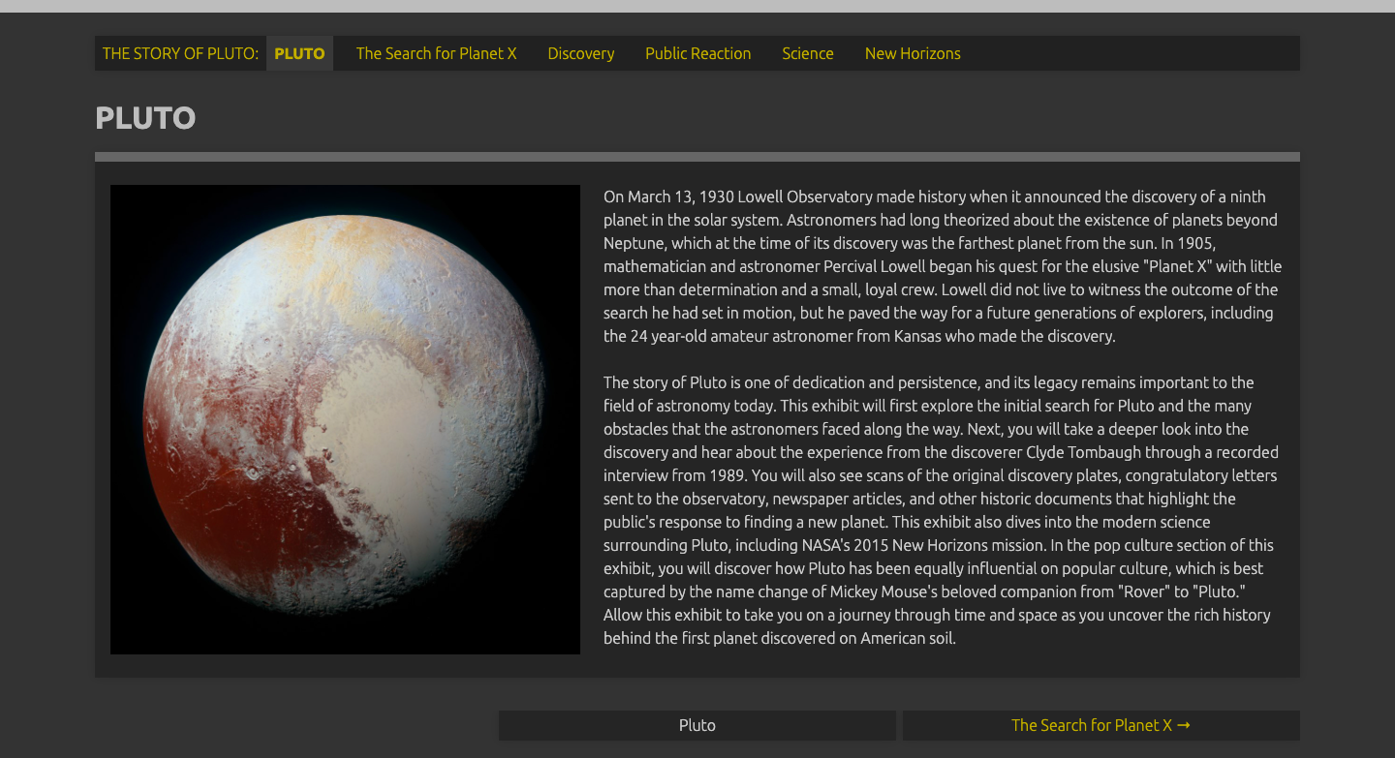
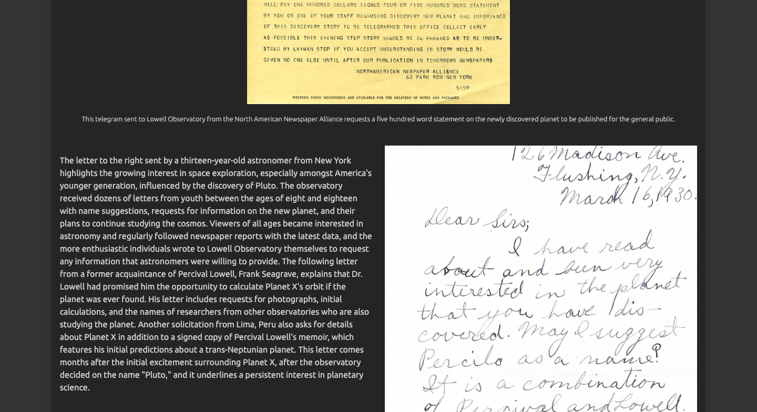
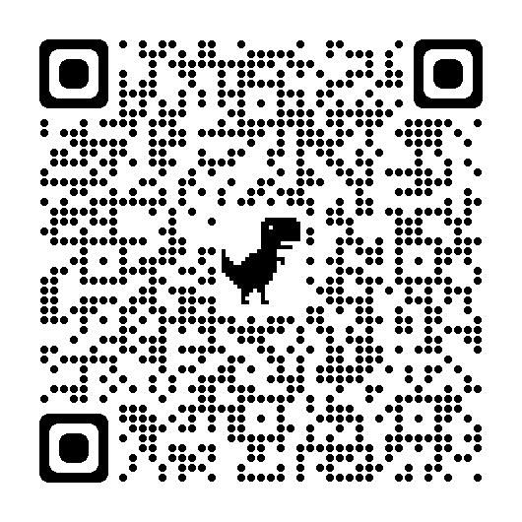
Scan here to visit
the exhibit!

Slide 10
Thank You!

